Slide 1
Phonics Workshop
Thursday 29th September 2022
Abbots Ripton CE School

Slide 2
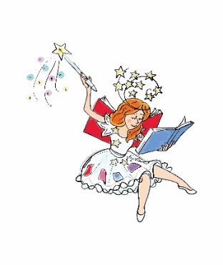
Phonics
We teach phonics through a systematic synthetic
approach which is a structured approach to teaching children to read. This method of reading helps children to learn the relationships between the sounds (phonemes) of spoken language and the letter symbols (graphemes) of the written language.
We use a scheme called ‘Story Time Phonics’ to teach the letters and sounds. This is a fun, innovative way of teaching. Each sound is introduced by the Phonic Fairy in the context of real picture books.

Slide 3
Terminology
Phoneme
Phoneme - a unit of sound
Grapheme - the written sound
Segmenting and blending
Digraph - two letters that make a sound
Trigraph - three letters that make a sound
Split digraph - the two letters that make the sound are split with a consonant in between - a-e as in cave

Slide 4
Phase 1
There are 7 aspects within this phase.
A1 – Environmental sounds
A2 – Instrumental sounds
A3 – Body Percussion
A4 – Rhythm and rhyme
A5 – Alliteration
A6 – Voice sounds
A7 – Oral blending and segmenting. A child needs to be able to blend the individual sounds into words.

Slide 5
Segmenting
Breaking down words for spelling
cat
c a t

Slide 6
Segmenting
queen
qu ee n

Slide 7
Blending
Building words from phonemes to read.
c a t
cat

Slide 8
Blending
qu ee n
queen

Slide 9
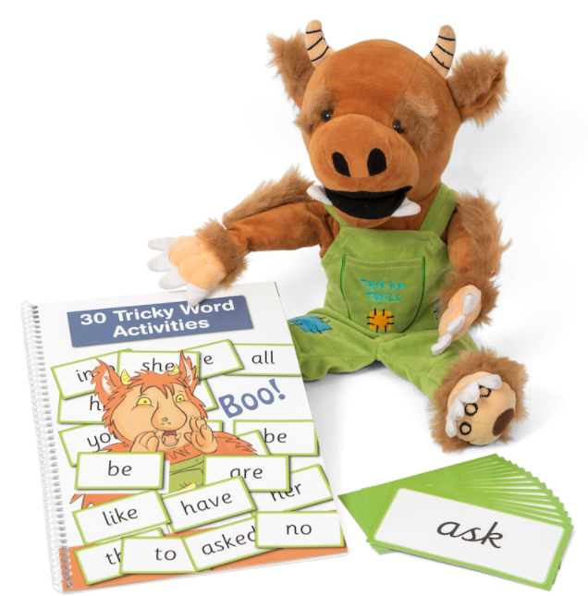
Phase 2-RECEPtion
Set 1: s, a, t, p
Set 2: i, n, m, d
Set 3: g, o, c, k
Set 4: ck, e, u, r
Set 5: h, b, f, ff, l, ll, ss
‘Tricky Words’; I, no, to, go, into

Slide 10
Phase 3-RECEPtion
Set 6: j, v, w, x
Set 7: y, z, zz, qu
Consonant digraphs: ch, sh, th, ng
Vowel digraphs: ai, ee, igh, oa, oo, ar, or, ur, ow, oi, ear, air, ure, er
Tricky Words: we, he, me, she, be, was, my, you, they, her, all, are

Slide 11
Phase 4-RECEPtion
This phase consolidates all the children have learnt in phases 2 and 3, and helps them use and apply their reading and spelling skills.

Slide 12
Phase 5-Year 1
Children will be taught new graphemes and alternative pronunciations for these graphemes.
Vowel digraphs: wh, ph, ay, ou, ie, ea, oy, ir, ue, aw, ew, oe, au
Split digraphs: a_e, e_e, i_e, o_e, u_e

Slide 13
Phase 6-Year 2
The focus is on learning spelling rules for suffixes.
-s -es -ing -ed
-er -est -y -en
-ful -ly -ment -ness

Slide 14
Saying the sounds
https://home.oxfordowl.co.uk/reading/what-is-letters-and-sounds/
Website

Slide 15
What does a Phonics lesson look like?
Revisit/review | A selection of sounds is chosen to review, each with their ‘caption action’.
Teach | The sound is introduced through the Phonic Fairy and the reading of a new book.
Practise | The sound is practised for reading and writing.
Apply | The children then read or write words in different ways.

Slide 16
Resources
School Website and phonic journal
http://www.phonicsplay.co.uk
http://www.oxfordowl.co.uk/for-home/reading-owl/expert-help/phonics-made-easy

Slide 17
Year 1 Phonic Check

Slide 18
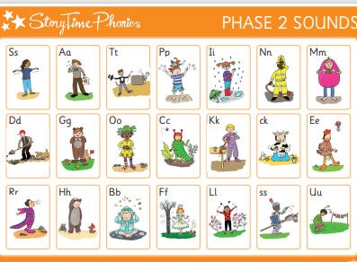
Reading at home
Initially the sounds are sent home on a Friday as they are learnt in school.
Go through the sounds or tricky words in the Phonic Journal, practising the ‘caption actions’ to support remembering the sounds.
There is no need to do anything in the Phonic Journal; it is just a reference point for you to help your child with their memory of the sounds and caption actions.

Slide 19
As the year progresses, reading books are sent home.
Encourage children to look at the pictures first and talk about the story. Can they predict what may happen? Can they recall the key events in the story? Who are the characters? We use decodable books to support early reading skills. The children need to sound out words and blend them back together again. We call these ‘I read’ books – you will begin to see IR in the reading diary. Your child should be able to read all of the words in this book. However, if your child is tired, share the reading together by doing a page each, reading a speech bubble or by completing the book for them. Books may come home more than once to support fluency.

Slide 20
Please do keep reading to your child for pleasure to foster a love of reading. Children will choose a, ‘You Read’ (YR) book which is for you to read to them – they have a wide choice in school.
Later in the year or in Year 1 your child may receive a ‘We Read’ (WR) book and this will be a book which your child will be able to read mostly by them selves but may come across words which you will need to read for them.

